Slide 1

Analysis of Crime in London
Thomas Baldwin and Jaden Mighten

Slide 2
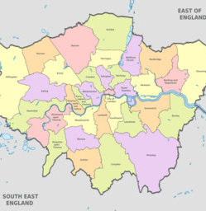
How does the level of crime change across the city and why?

Slide 3

Initial Goals
What were your initial goals? What was the objective of your investigation?
OBJECTIVE: To explore how crime rates differ throughout London
To find out which areas are the safest and whether that be for potential investors looking to set up businesses, homeowners entering the property market, or commuters travelling through these areas
Have a clear data set of relatively well defined and formatted data using the UK government database
This is a project that we can complete given our limited programming knowledge as we have little experience in programming and data science outside of self study

Slide 4



Goals
Have your goals changed since starting the project? If it has, why and how?
Our goals have not changed significantly but we thought it would be interesting to compare the data of crime to median incomes in that area so understand the causes of the crime patterns in different areas
We have, become a lot more confident using python for plotting and have been exploring other tools such as Tableau and Google Data Studio

Slide 5
Datasets
Which datasets were you able to find? What kind of data do they contain?
Initial Challenges when looking for datasets:
We installing looked on Kaggle but the data we found was often incomplete and not well organized
Datasets we looked at were taken from the London Data Store:
MPS _Borough_Level_Crime.csv – we chose this dataset because the crimes were clearly labeled by type and subcategories and by borough
Earnings-residence-borough.xls – specifies income statistics classified by borough so we can maybe provide some explanation for certain crime trends
Problems Faced:
Crime of all severities are grouped together - e.g., crimes against the person include violence without injury and homicide – we will need to manually create our own categories baes on severity and relevance of the crime
For the median income per borough – the data is categorized into monthly, weekly and hourly and the further sub-catergorised by gender and part-time/full-time jobs

Slide 6
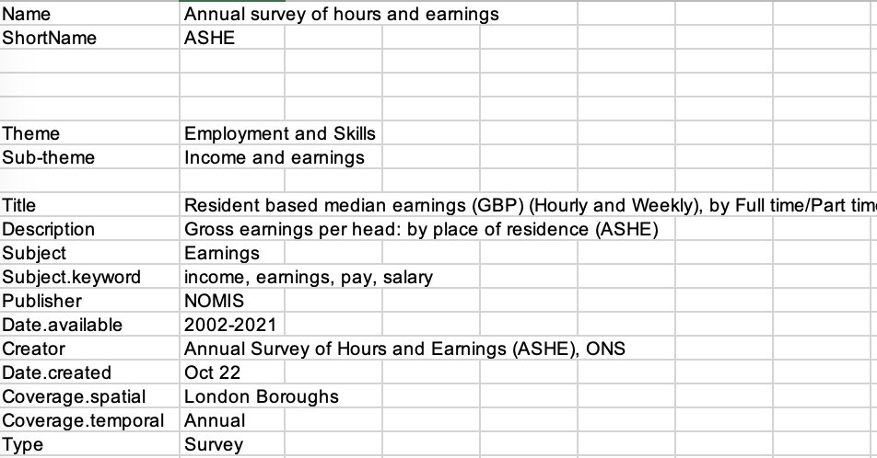

Slide 7
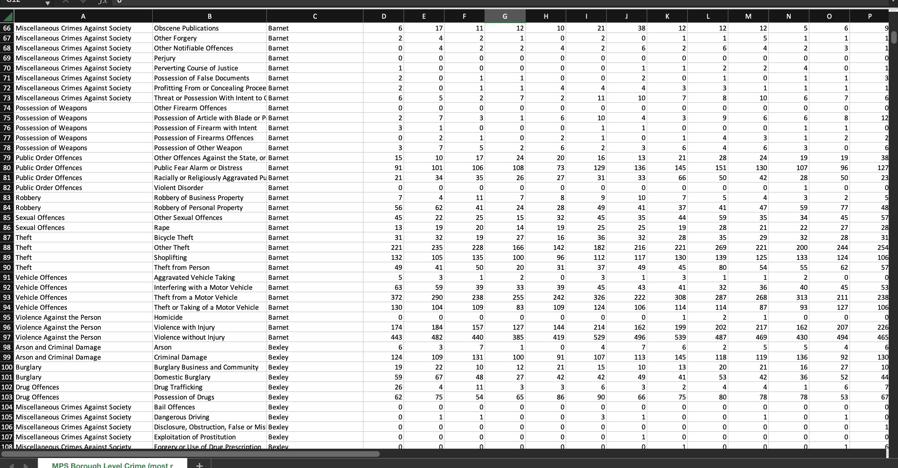

Slide 8
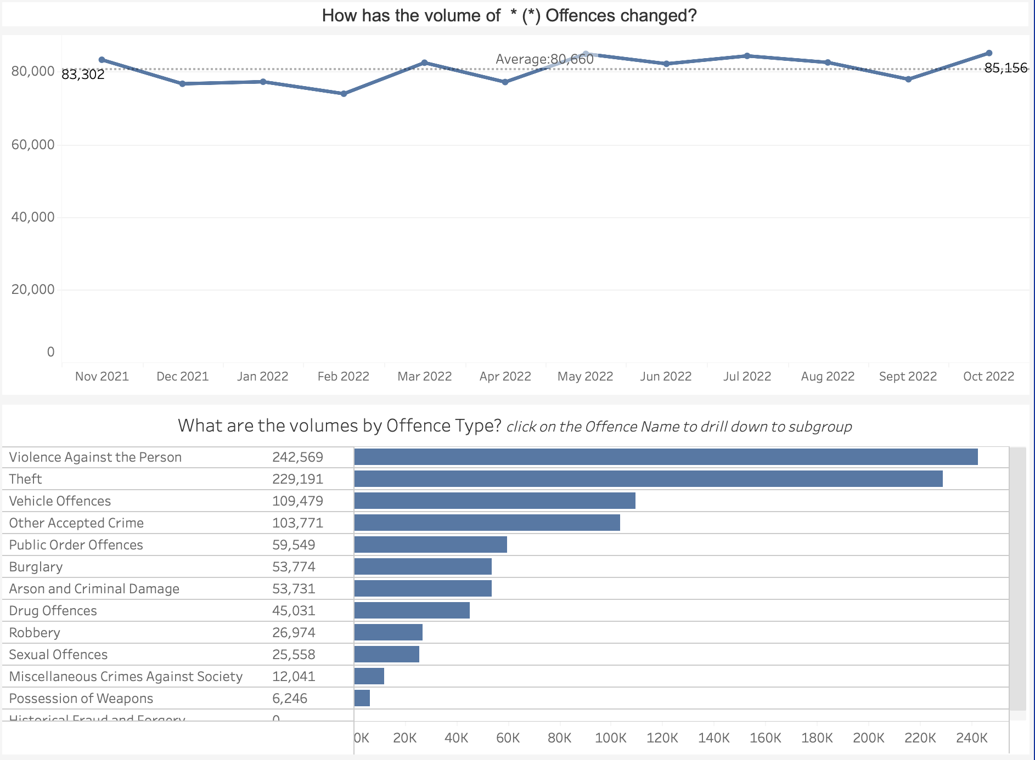

Slide 9
Datasets
How will these data sets help to answer your questions?
Primarily the crime data set will allow us to create a map specific to both crime in general as well as by crime category and sub-category – this will help us to identify potential patterns between each area and crime rate e.g., corelate with how central the brough is, median income in that borough, median property prices
Note: we are using the median here instead of the mean to avoid skewness from datapoints massively under or over the trend for that borough
The data set will also tell us which borough are worst for each type of crime e.g., business crime vs violent crime
We can use regression models to quantify these correlations and then test our hypothesis to a necessary significance level
We can use our findings to draw broader conclusions about inequality throughout London and the driving factors behind cyclical inequality

Slide 10
Datasets
Have you settled on the data sets you will use or do you plan to search for more data?
The data sets for the main bulk of the projects are pretty much settled on although we could use more data if we want o delve more into the correlation between the crime rate in the boroughs and different statistics to do with poverty and inequality
To understand the causality of these correlations we can look at academic journals and papers to understand why these crime distributions occur and further investigate borough specific schemes and policies by the local councils which may cause discrepancies in crime rates
Reliability of Datasets:
Data is likely to be of the highest quality as the data compiled in the London Datastore is from the ONS
This data is all publicly available to access

Slide 11
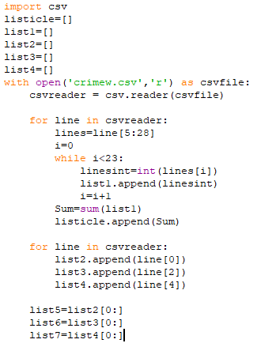
Transforming CSV file into usable lists
As our data source is quite simple and requires minimal formatting, we can import the package ‘csv’ and utilize the built-in function ‘open’ to access our data
One issue that we ran into was that as the code is a csv file, python does not know where the header is. Therefore, we had to use indexing in the last 3 lines to prevent the headings being appended into our lists.

Slide 12
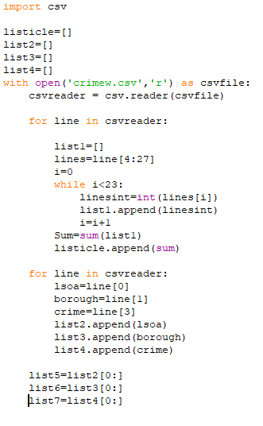
Data cleaning
As our data is stored in csv format the amount of cleaning required is fairly minimal.
We could remove irrelevant columns such as LSOA name and Minor category
Doing so would reduce the amount of time it takes for our program to run, however we would have to adjust our code to the following:

Slide 13
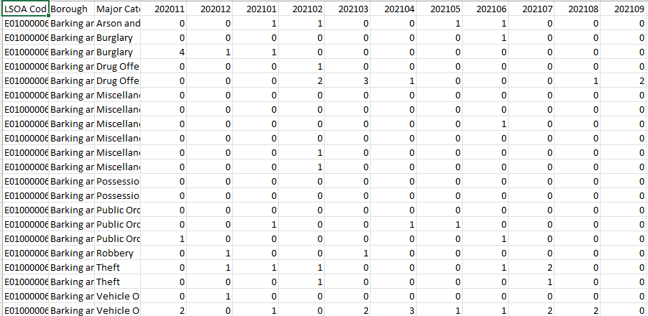
Data Cleaning pt 2
This would result in the data frame changing from what we saw initially to this augmented version with 2 less columns and 205000 less entries onto our data frame.
This reduced the size of the data frame by over 25% from 12.76mb to 9mb

Slide 14
Size of data
Overall there are 29 columns in our data frame and 102,576 rows
This means that there are 2979953 entries in our uncleaned data frame
29 of these are column names (str data type)
308,271 of these relate to the location of the crime (str data type)
205,514 of these relate to the type of crime (str data type)
The rest of these relate to specific instances of crime (str data type converted to int through cleaning)
In our initial data frame all data is a string but in our cleaned data frame we have integers as well

Slide 15
Data exploration
Borough | Population
 | (2019 est)
Barnet | 395,896
Croydon | 386,710
Newham | 353,134
Ealing | 341,806
Enfield | 333,794
Bromley | 332,336
Brent | 329,771
Wandsworth | 329,677
Lambeth | 326,034
Tower Hamlets | 324,745
Southwark | 318,830
Hillingdon | 306,870
Lewisham | 305,842
Redbridge | 305,222
Greenwich | 287,942
Hackney | 281,120
Waltham Forest | 276,983
Hounslow | 271,523
Camden | 270,029
Haringey | 268,647
Westminster | 261,317
Havering | 259,552
Harrow | 251,160
Bexley | 248,287
Islington | 242,467
Barking and Dagenham | 212,906
Merton | 206,548
Sutton | 206,349
Richmond upon Thames | 198,019
Hammersmith and Fulham^{[note 4]} | 185,143
Kingston upon Thames | 177,507
City of London | 9,721
Kensington and Chelsea | 156,130
Local authority | Income deprivation rank within London
Hackney | 1
Barking and Dagenham | 2
Tower Hamlets | 3
Islington | 4
Enfield | 5
Haringey | 6
Newham | 7
Lewisham | 8
Southwark | 9
Greenwich | 10
Brent | 11
Lambeth | 12
Waltham Forest | 13
Hammersmith and Fulham | 14
Camden | 15
Ealing | 16
Croydon | 17
Westminster | 18
Hounslow | 19
Redbridge | 20
Kensington and Chelsea | 21
Hillingdon | 22
Barnet | 23
Harrow | 24
Havering | 25
Wandsworth | 26
Bexley | 27
Merton | 28
Sutton | 29
Bromley | 30
Kingston upon Thames | 31
City of London | 32
Richmond upon Thames | 33
We have gathered population data for each borough alongside income deprivation data.
Once we have completed filtering our crime data by borough, we will be able to visually see whether the rankings by crime rate and rankings by income deprivation have any correlation.

Slide 16
3 week plan
Finish filtering data and write code to check the correlation between crime rate and various factors such as income deprivation
Decide on the statistical technique used to compare correlation between variables ie OLS regression or a simple visual plot
Create GitHub repository and begin writing ReadMe file
Document our story over time so that we can explain it on our website
Decide on domain name and design ideas/functionality for our website

